Slide 1
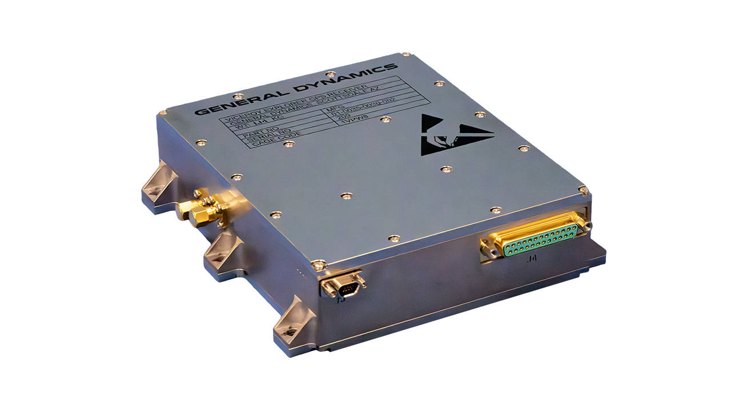
Assignment – Due Date: 3/24
Your task is to design the enclosure (casing) of an electronic box to protect the sensitive electronics components inside.
Requirements:
Mission Orbit: MEO
Mission Duration: 15 years
Max. Volume: 10cm x 10cm x 5cm
Mass Budget for the enclosure: 0.25 Kg
Provide answer the following:
What is the expected Total Dose for the given orbit and mission life? You must also include your assumptions.
What’s the best material for the enclosure?
How thick does the wall need to be?
Total mass of the enclosure?
What other design techniques should be considered in order to save mass?
Example: GPS Receiver

Slide 2
Note: It’s permissible to use AI tools in deriving parts of the solutions but you must state the tool used and validate the answers. DO NOT use AI tool to generate the answer by coping and pasting the complete assignment into any AI tool.
請勿使用 AI 產生完整的全部答案
Submit your a to:
https://eeclass.nthu.edu.tw/course/homeworkList/31582

